Slide 1
DATABASE DESIGN PROJECT.
PRESENTED BY;
Mercy
Kefa
Melvin
Adrian

Slide 2
Agenda/content of the presentation.
Database background. Under database background we shall have;
Objective of the database
Kind of database
Characteristics of our database
Logical data model through an ERD
Normalization of the database
Database design schema

Slide 3
Title and Content Layout with Chart
The main objective of the database created would be to store, input and retrieve data of a diversified company with more than six businesses that are completely different in nature with operational data locked within each business.
For the kind of database, this would be a relational database management system(RDBMS) which is a program used to create, update and manage relational databases and in this case from our question we can see that the six businesses are related being that they are under the same company and that's why we are creating the database so it's the RDBMS.
This database will have the following characteristics;
For the data manipulation language, we use SQL to enable users to insert, update/ edit, delete and retrieve data.
The source of data will be data entry since users can manually insert the data into the database.

Slide 4
LOGICAL DATA MODEL THROUGH AN ENTITY RELATIONSHIP DIAGRAM.
While creating an entity relation diagram(ERD) for the six businesses, there are some key entities that must be there. These entities are:
Products
Customers
Employees
Suppliers
The six businesses
These five entities will be interconnected through an ERD to represent flow of data within the company.

Slide 5
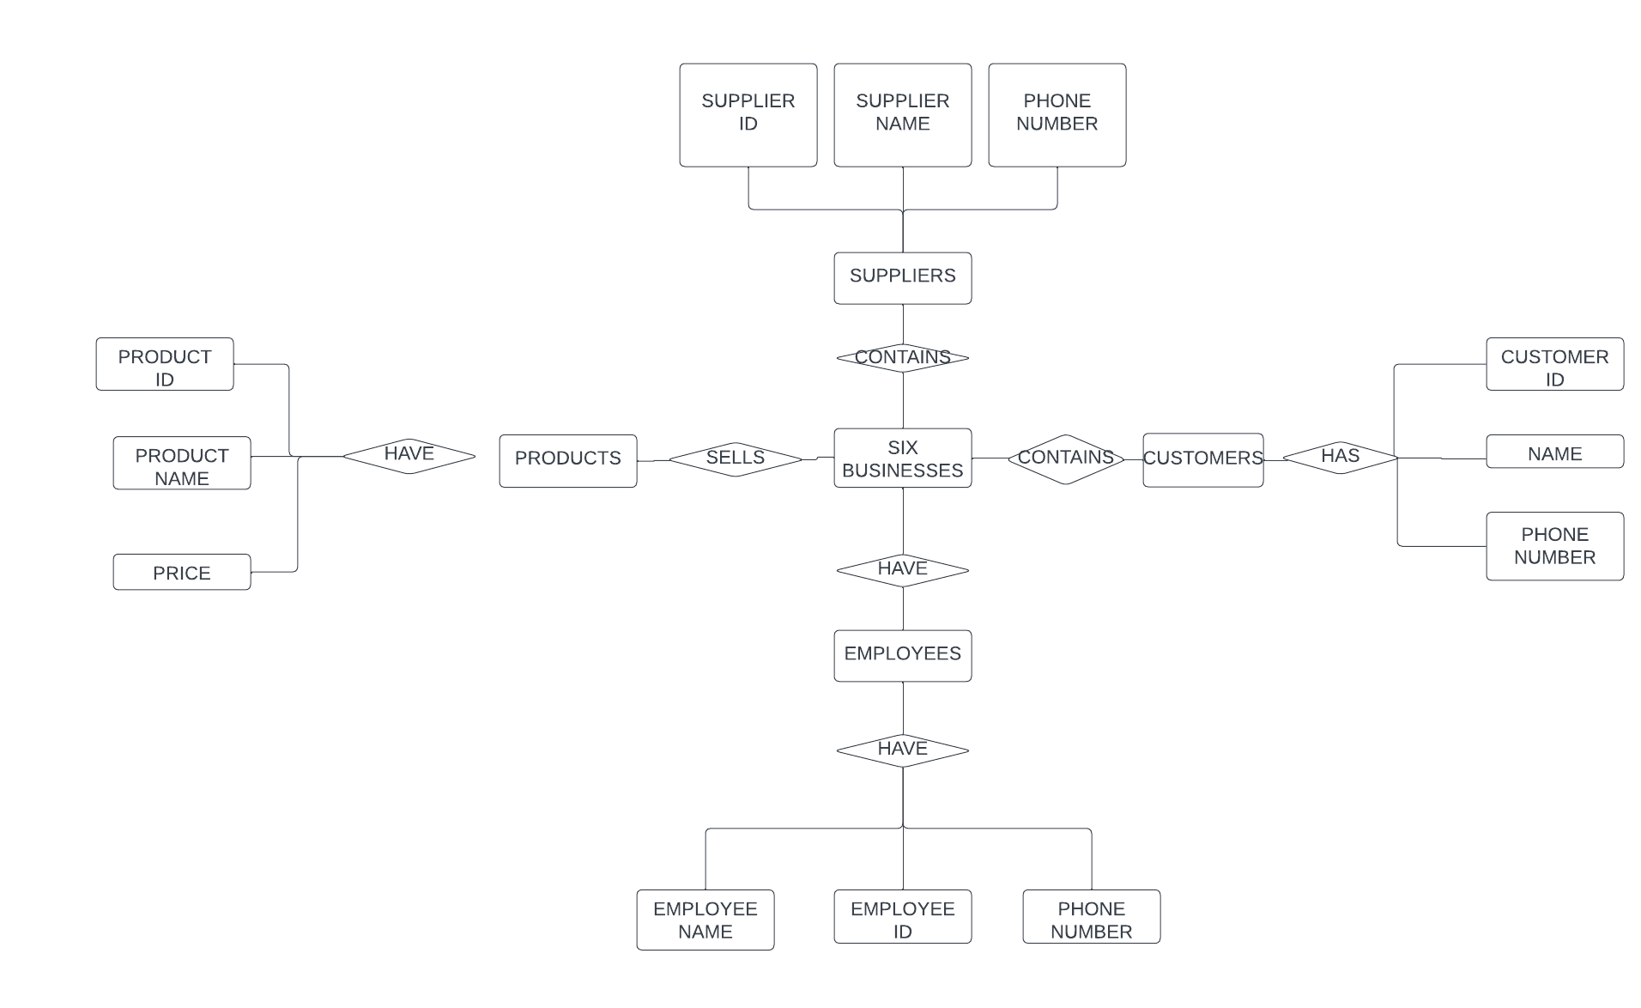
CONTINUATION OF PREVIOUS SLIDE……………
The logical data model would be represented in an ERD as follows;

Slide 6
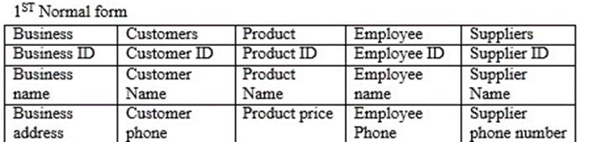
NORMALIZATION.
First normal form; to achieve first normal form, you need to remove all repeating groups.

Slide 7
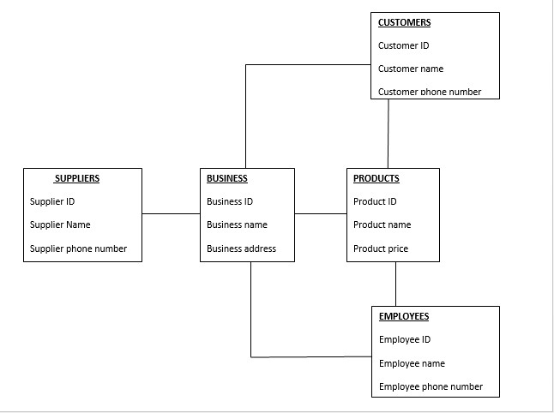
DATABASE DESIGN SCHEMA.
A database design schema is basically a database's blueprint. It lists the database's tables, each table's fields, and the connections between them. It may be star, network, or relational in nature.

Slide 8
END OF PRESENTATION
THANK YOU

